Slide 1
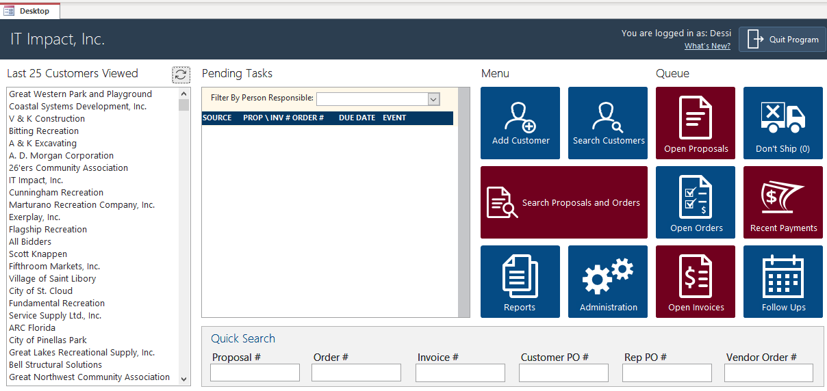
ITIMPACT.COM ACCESSEXPERTS.COM

Slide 2
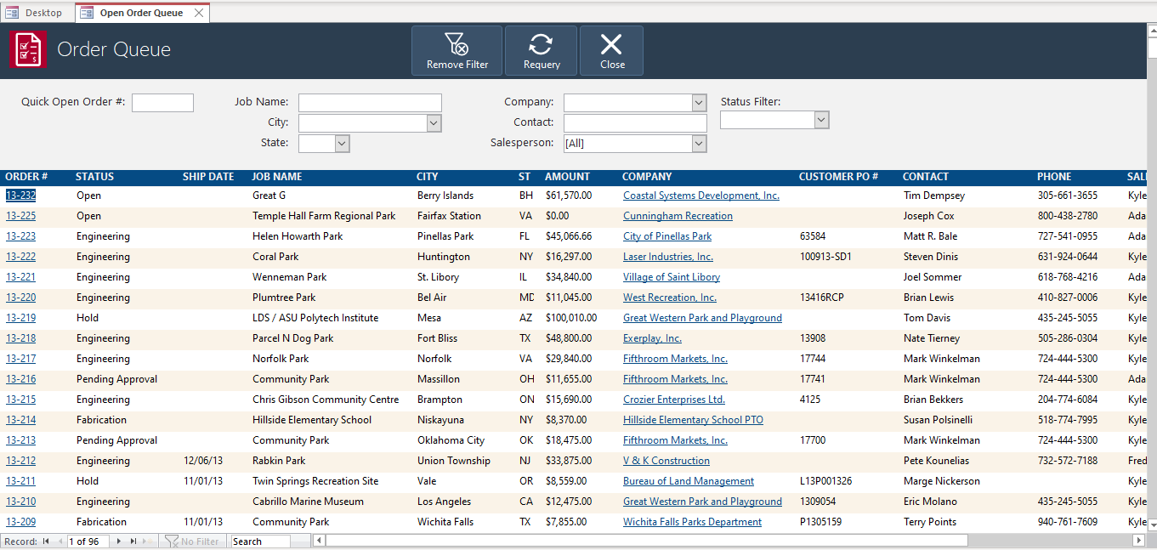
ITIMPACT.COM ACCESSEXPERTS.COM

Slide 3
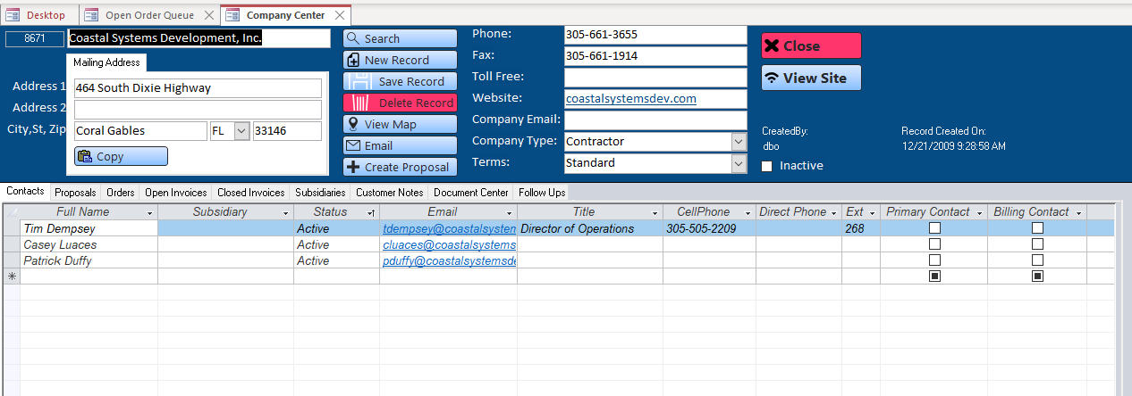
ITIMPACT.COM ACCESSEXPERTS.COM

Slide 4
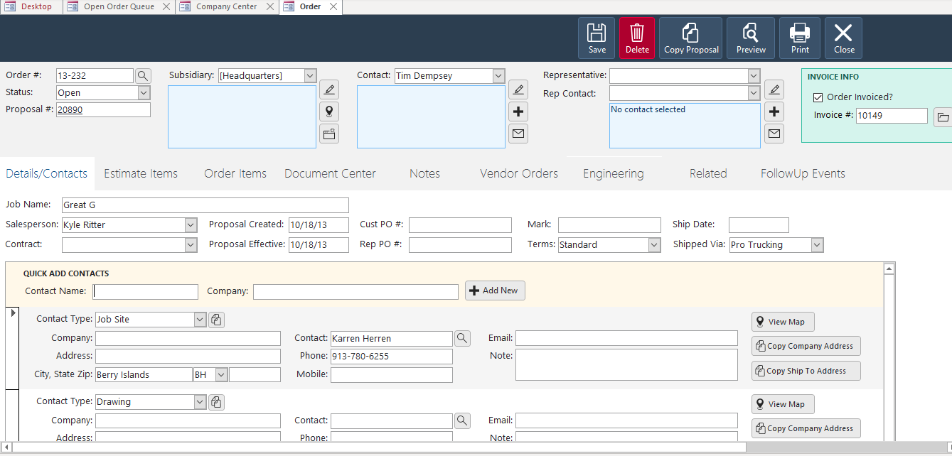
ITIMPACT.COM ACCESSEXPERTS.COM

Slide 5
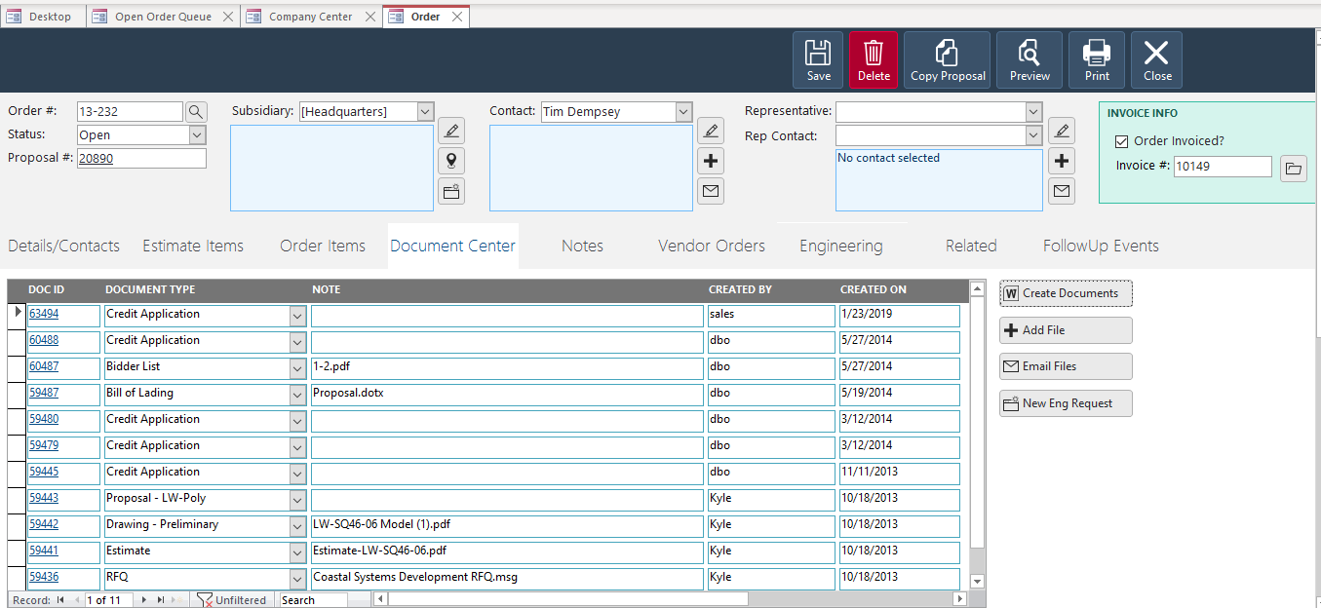
ITIMPACT.COM ACCESSEXPERTS.COM

Slide 6
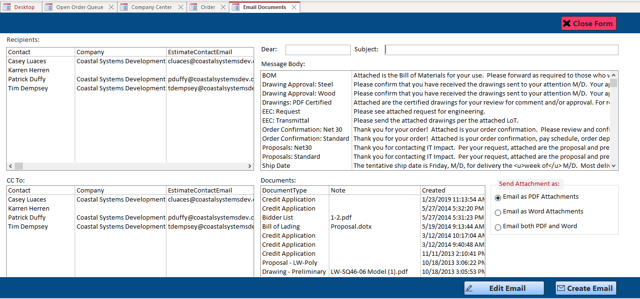
ITIMPACT.COM ACCESSEXPERTS.COM

Slide 7
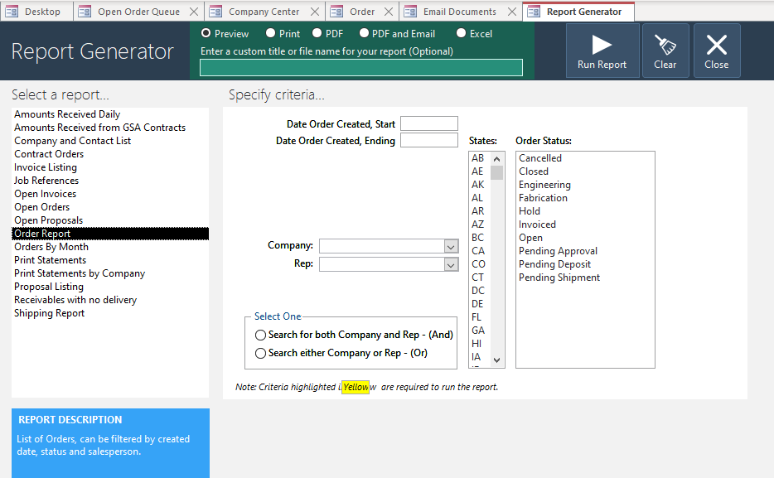
ITIMPACT.COM ACCESSEXPERTS.COM

